Slide 1
Requirement Specifications for Enhanced Job and Candidate Application
Prepared By:
Simul Kadakia
Wesley Trescott
Gagandeep Singh

Slide 2
Introduction
Purpose
Provide a detailed description of the functionalities of the ‘Enhanced Job and Candidate Application’ system.
Provide details of the system’s intended features, as well as offer a preliminary glimpse of the software application’s User Interface (UI).
Provide details about hardware, software, and various other technical dependencies.

Slide 3
Introduction
Scope
‘Enhanced Job and Candidate Application’ is a web application where Wayne State University students can search for jobs based on their skill sets and apply to those they are interested in.
Users can log into a secure portal where they can access their saved data such as email address, contact information, and experience. They can filter job searches based on specific criteria, such as location and industry, which will narrow the search results of the available jobs. Students can apply to the jobs that they are interested in, with the option of uploading a resume.

Slide 4
Introduction
Definitions, Acronyms, & Abbreviations.
Table 1

Slide 5
Term | Definition
EJCA | Enhanced Job and Candidate Application
User | Job seekers who uses the application
Admin/Administrator | System administrator who is given specific permission for managing and controlling the system
Admin portal | Part of web application which provides special facilities to Admin/Administrator
Stakeholder | Any person who interacts with the application except developers
API (Application Programming Interface) | A generalized interface used to allow EJCA to interact with external software/application (Pinpoint).
Front end | The aspect of application that user interacts with
Back end | The aspect of application that is developed and maintained by developers.
UI (User Interface) | Front end of EJCA
DESC | Description
DEP | Dependency
MUST | The minimum level required to avoid failure
PLAN | The level at which good success can be claimed
WISH | A desirable level of achievement that may not be attainable through available means

Slide 6
General Description
Product Perspective:
The project is built from scratch
there is no initial foundation
System will consist of a backend and a frontend.
Backend: Handle the storage of jobs listing and user information data, as well as the querying and delivery of this data back to the frontend to be displayed.
Frontend: allow a user to interact directly with a webpage which will allow a user to specify a particular filter and then send a query to the backend to retrieve data.

Slide 7
General Description
Product Functions:
User can login
User can browse open job listings
User can search/filter based on certain criteria
User can apply to jobs
User can check what jobs they have applied to
Admin can login
Admin can search for users by their first and last name
Admin can lock/ban/delete users

Slide 8
General Description
User Characteristics:
2 Types of Users:
Job Applicant:
Considered the most important users
majority of site views because the web app is mainly focused on delivering content to them.
Most potential users will simply browse job listings until they find job listing(s) they are interested in at which point they can apply.
Admin:
Considered second most important users of our site.
lock, ban and remove users who abuse the application.

Slide 9
General Description
General Constraints:
This is a web application and the details about the operating environment are not important. End users will use the application from a modern internet browser such as Firefox, Chrome and Internet Explorer.
Assumptions and Dependencies
Assumptions to properly use the application include:
Internet connection with enough bandwidth to fully render various displays
A modern browser with up to date technologies, such as a modern JavaScript engine

Slide 10
Specific Requirements
External Interface Requirements:
User Interface:
Job search page displayed when the application is opened. Here the user chooses the type of search he/she wants to conduct. There will also be a Login link if the user wants to login to their account and Register link if the user wants to create a new account.
Some preliminary UI

Slide 11
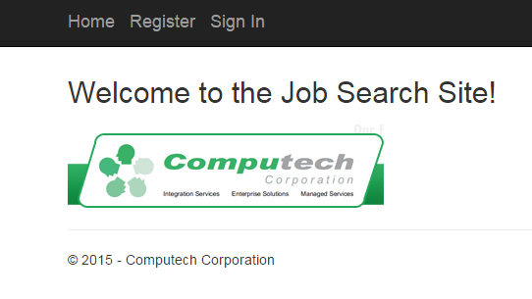
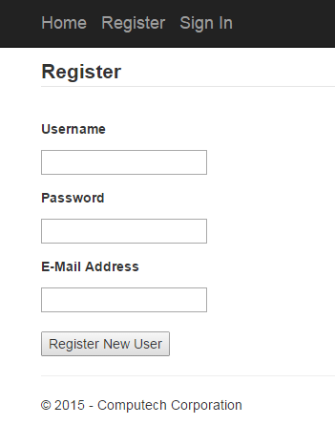
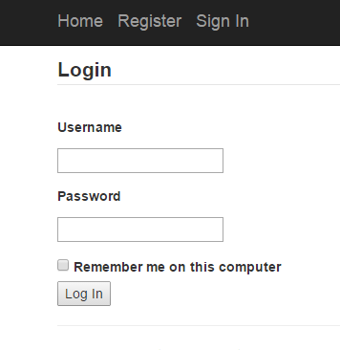

Slide 12
Specific Requirements
Hardware Interfaces
EJCA does not use any hardware interfaces.
Software Interfaces
EJCA will run on MVC architecture. The messages passed would be GET and POST requests from the user or admin, as well as calls to insert, delete, or select data from our database.
Communications Interfaces
The communication between the different parts of the system is important since they depend on each other. However, in what way the communication is achieved is not important for the system and is therefore handled by the server where the application is deployed on.

Slide 13
Specific Requirements
FR | TITLE | DESCRIPTION | REQ
3.2.1.1 | Search | User can search for various jobs available. When user opens the website, the page will show available jobs. User can search among these jobs. | None
3.2.1.2 | Register | User can create a new account by providing personal information such as email id, password and first and last name. This information will be stored in database and email id and password will be used to log in user. | None
3.2.1.3 | Login | Given that a user has registered, then the user can login by entering email id and password entered during registration process. | 3.2.1.2
3.2.1.4 | Retrieve Password | Given that a user has registered, then the user should be able to retrieve password through email. User can request to change password which will send further instruction to their email. | 3.2.1.2
3.2.1.5 | Apply | Given that a user is logged in, the first page they can see is the home page. User can search/filter jobs and apply for jobs. | 3.2.1.3
3.2.1.6 | Filter by skills, location, and experience | User can filter jobs based on skills, location and experience required for the job. Jobs can be filtered based on single criteria or multiple criteria. | None
3.2.1.7 | Profile Information | Given that a user is logged in, then the user can enter their information such as skills and experience in profile page. User can store their information which can be used to autofill fields when applying for a job. | 3.2.1.3
3.2.1.8 | Change Information | Given that a user is logged in, then the user can change information stored in their profile page. User should be able to change any fields stored in their profile page. | 3.2.1.3
3.2.1.9 | Upload Resume | Given that a user is logged in, then the user can upload a resume and attach it to their profile. User can only attach one resume file which will be stored in their profile information in the database. | 3.2.1.3
Functional Requirements
User Class – Job Seeker

Slide 15
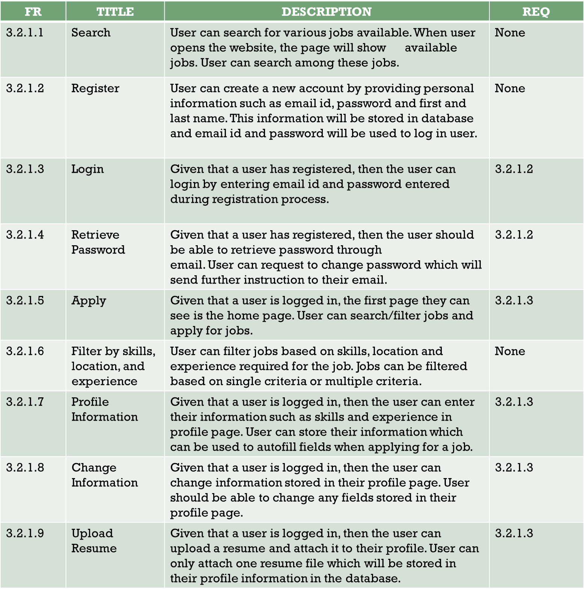

Slide 16
Specific Requirements
Functional Requirement
User Class – Admin
FR | Title | Description | REQ
3.2.2.1 | Login | Admin can login by entering email id and password stored in database. Admin information is stored in database and there is no registration page for admin. | None
3.2.2.2 | Search | Admin can search for all registered users by their first and/or last name. Admin can search for users which will display basic user information such as name, skills and so on. | 3.2.2.1
3.2.2.3 | Deactivate Users | Admin can deactivate users which will disable them to login into their account. Users who abuse the system can be deactivated by the admin which will lock them to log in to their account. | 3.2.2.1
3.2.2.4 | Delete Users | Admin can delete users which will delete all of their information from the database. Users who abuse the system can be deleted by the admin. All information related to user such as login and profile information will be deleted from the system. | 3.2.2.1

Slide 17
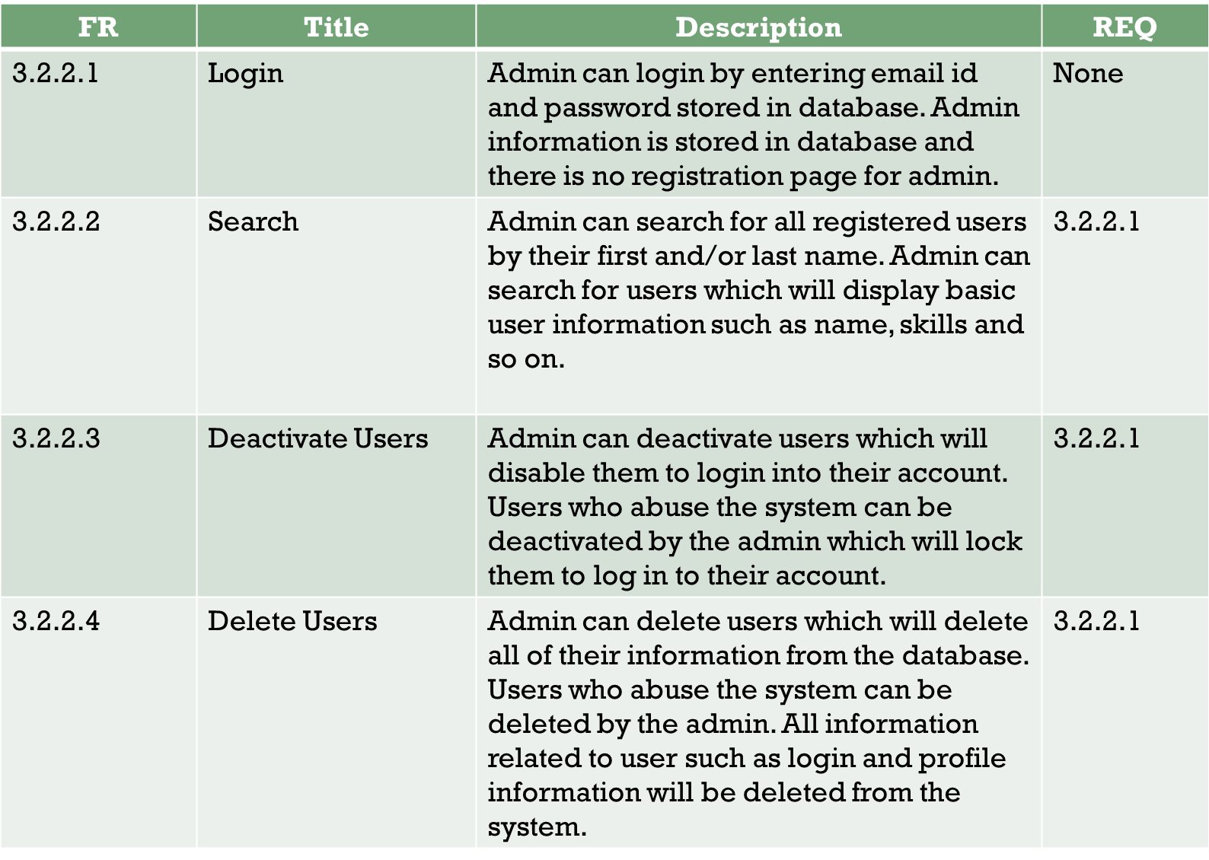

Slide 18
Specific Requirements
Non-Functional Requirements
Performance:
Response times should be quick as database queries deal with relatively small amount of information
We aim for overall loading quickness to be at a maximum of five seconds 100% of the time, with a target of less than two seconds 98% of the time, which will be verified during five hours of testing in our phase 3 system tests, as per our development plan.

Slide 19
Specific Requirements
Non-Functional Requirements
Reliability:
Produces the correct job search results based on valid search criteria, as well as suggests jobs to users based on their skills and experience.
Report messages to application users regarding lost internet connections or incorrect registration or search inputs.
In phase-3 testing, we will require correct error reporting 100% of the time, correct job search results 98% of the time, and correct job recommendations 98% of the time.

Slide 20
Specific Requirements
Non-Functional Requirements
Availability:
Accessibility of the application from an internet browser not considering network failures.
In testing, we plan for five hours of active use of the application, during which period our target system availability is 100% of the time, with a 98% of the time availability considered passing.

Slide 21
Specific Requirements
Non-Functional Requirements
Security:
Admin and all user passwords will be encrypted using the SHA1 encryption algorithm before being stored in the database.
SHA1 was developed by the NSA and is an example of a cryptographic hash function, considered nearly impossible to decode
Validation of user logins, so that incorrect user credentials will not result in access to the application.
Expected to function correctly 100% of the time in our tests.

Slide 22
Specific Requirements
Non-Functional Requirements
Maintainability:
Specifies the degree of extensibility and testability
Extensibility: both the easy addition of new features to the application and also the ease of portability to new, previously unsupported devices
Testability: take advantage of the test suites generated by ASP.NET for all of the functionalities of the application

Slide 23
Specific Requirements
Non-Functional Requirements
Portability:
Project requirement: compatible with both mobile and desktop environments
the application will be designed and coded so that all its functionality is compatible with web browsers in PC, Mac, Android, iPhone, and iPad. The effect of this multi-platform design intent is that the application will be easily portable to each supported environment.
Testing of all functionality of the application will be carried out on each supported device during phase 3 testing.

Slide 24
Specific Requirements
Design Constraints:
Require at most four gigabytes of RAM during normal use.
UI is constrained in size and complexity to support portability to touchscreen devices and devices with small screens.
Difficulty of implementing a social media login
Due to user data privacy constraints, logging into the application using the user’s social media account remains a challenge
Database Constraints:
A SQL Server database will be used in the backend to store information entered by the user, display jobs to users and display registered users to admin.
The front-end will be on the user/admin machine.

Slide 25
Specific Requirements
Mobile Platform Compatibility:
Compatible with mobile phones and tablets along with PCs,
primarily iOS and Android based devices.
User view is configured to the device’s screen resolution and can be accessed from any web browser installed on the device.
User has the ability to use every functionality in the app on these mobile devices.
User unable to upload resumes from iOS based devices.

Slide 26
Analysis Models
Level 1 DFD:
Shows the flow of data among the user, web application and the SQL database.
Diagram

Slide 27
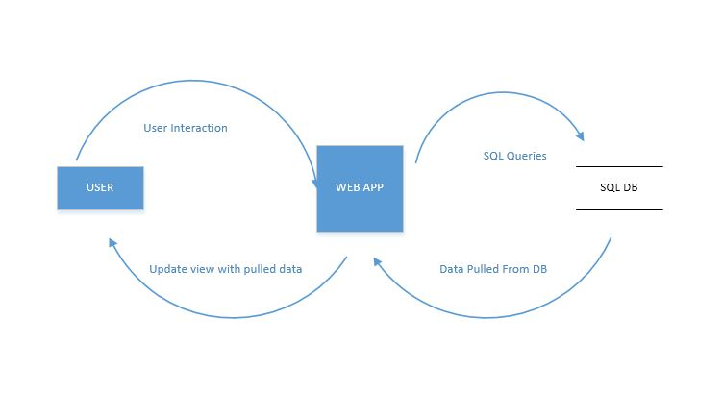

Slide 28
Analysis Models
Level 2 DFD:
Provides in-depth view of the data flow among the various components of the web application such as the UI, Application Core i.e. Model and Controller components, Viewer, and the SQL database.
Diagram

Slide 29
